Slide 1

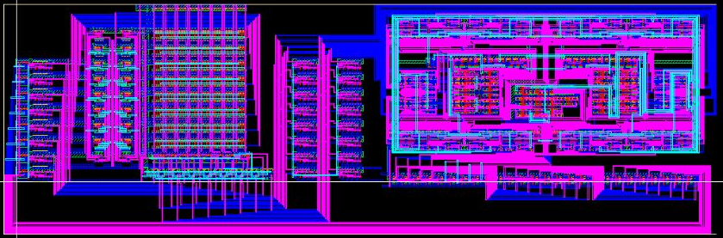
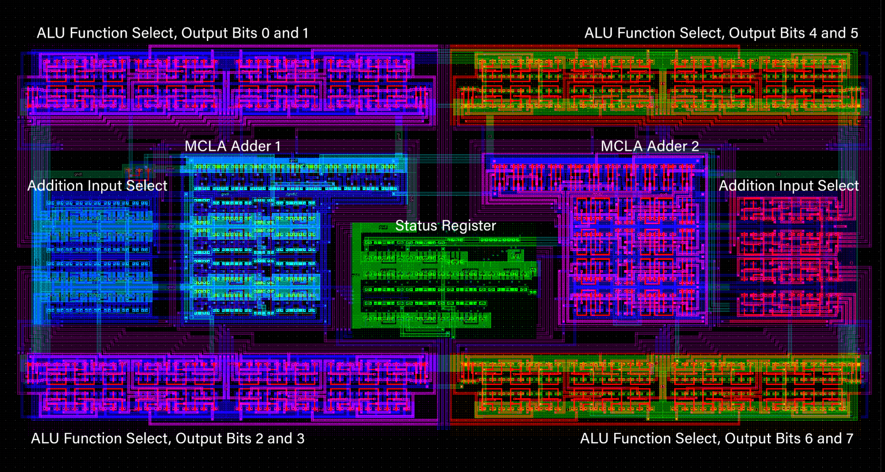
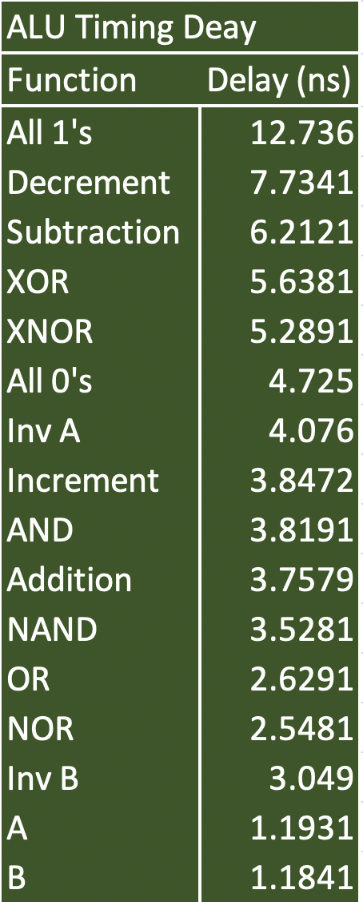
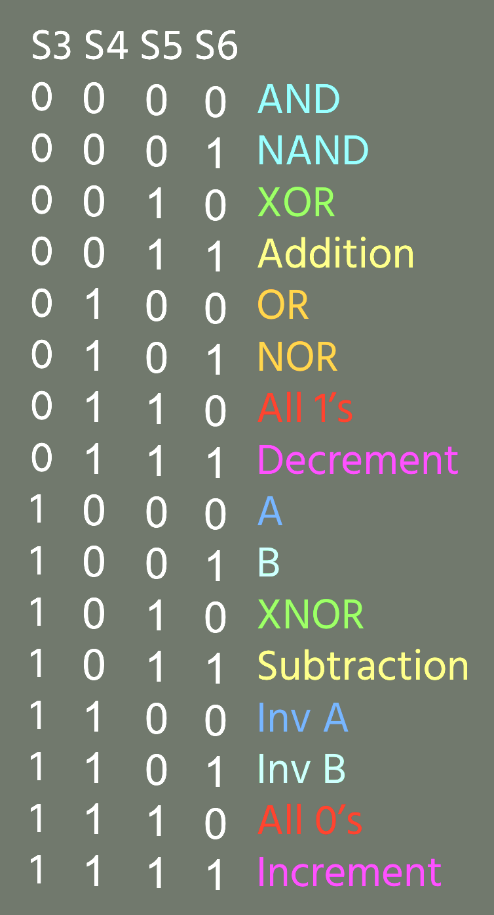
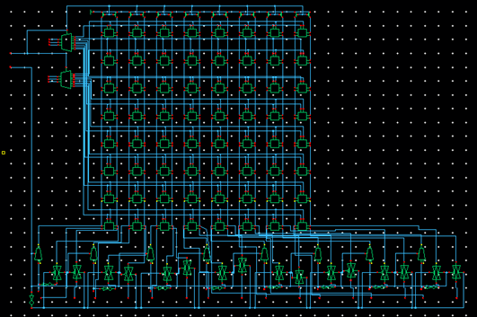
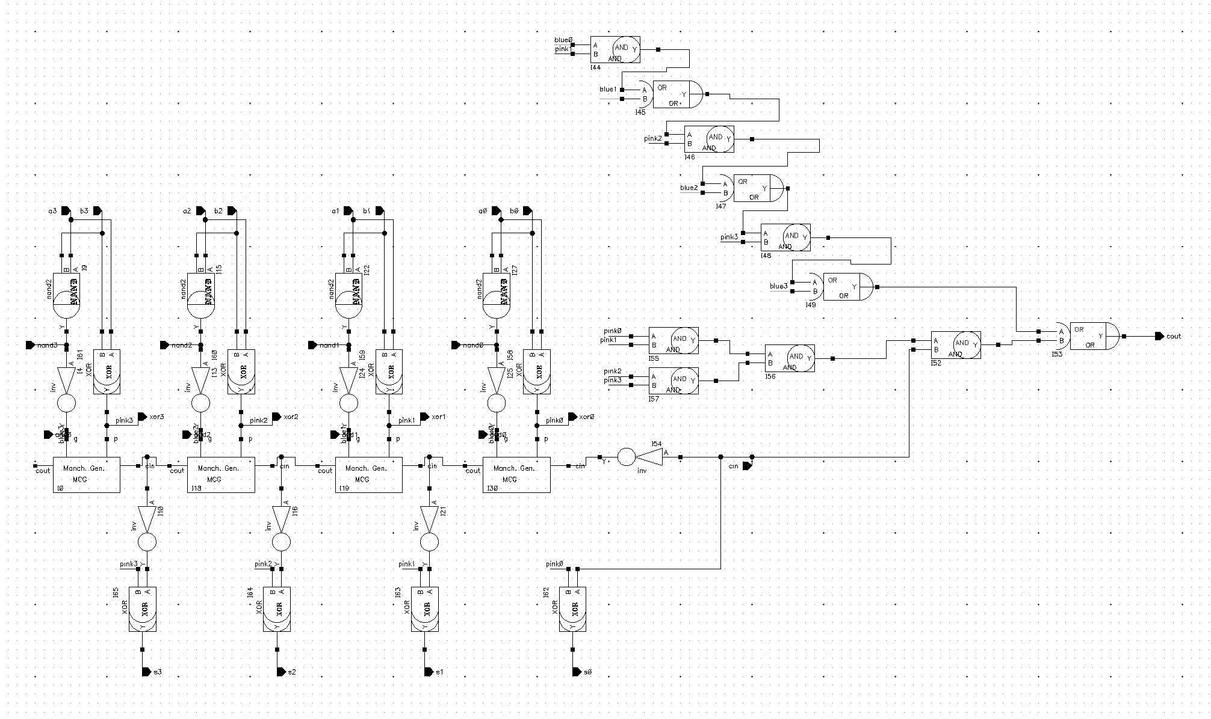
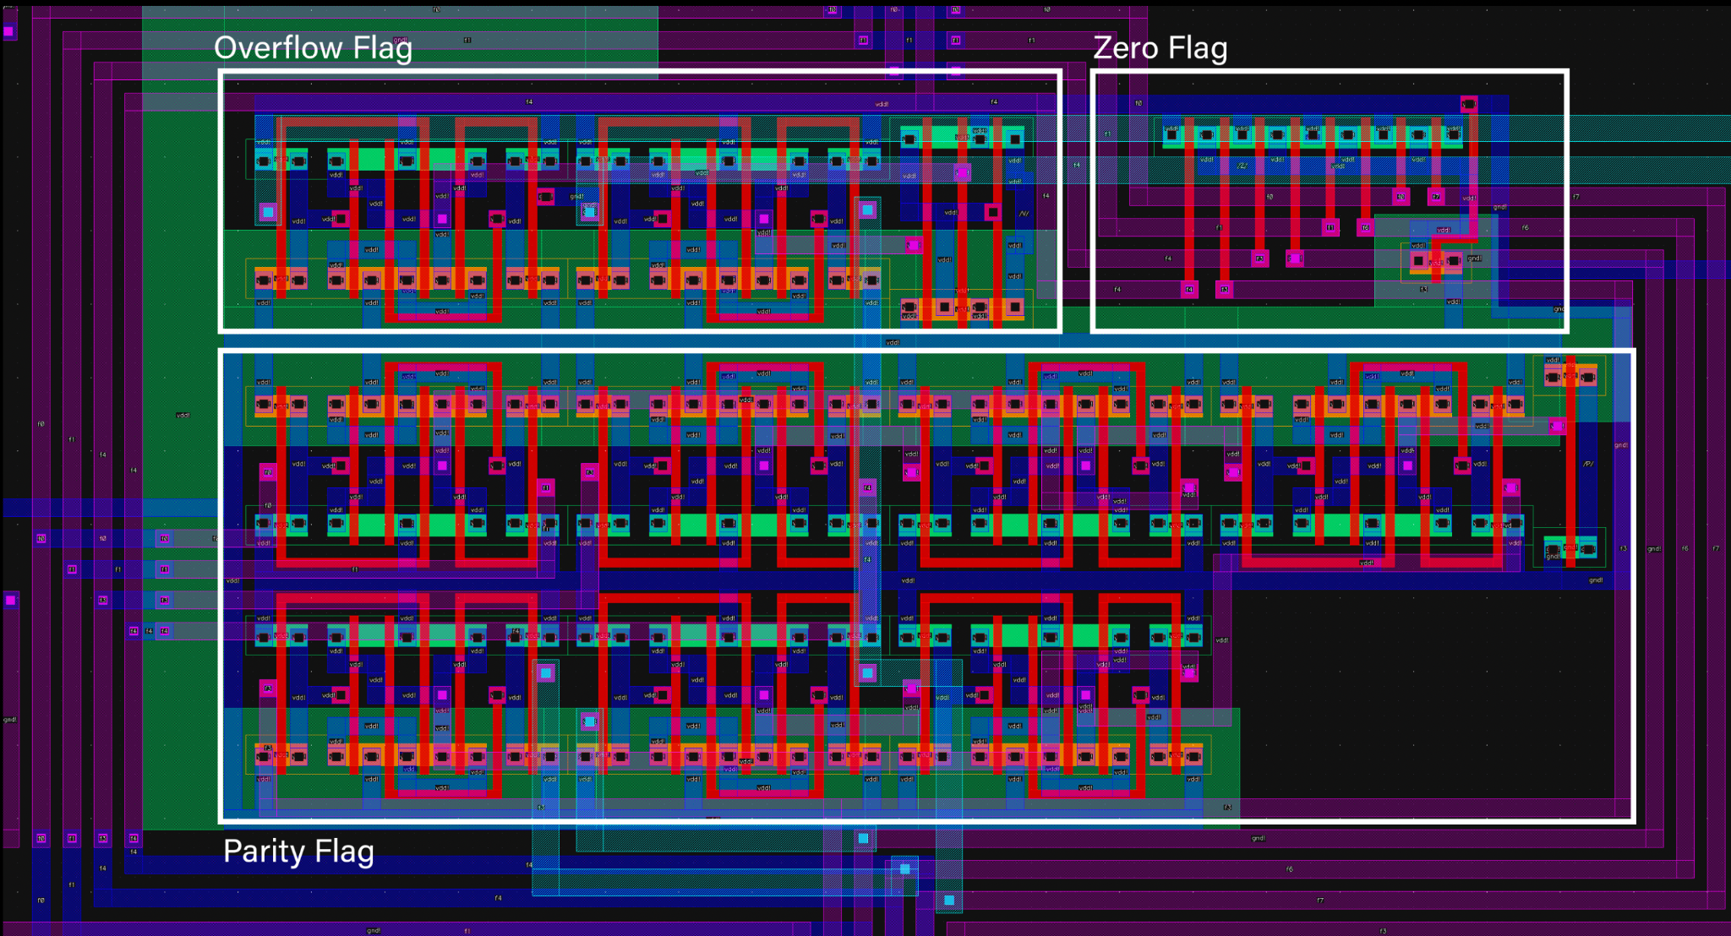
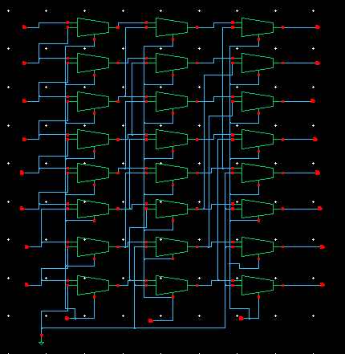
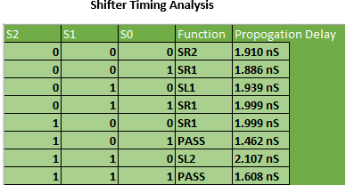
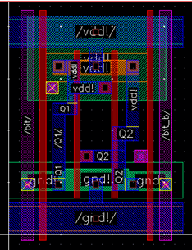
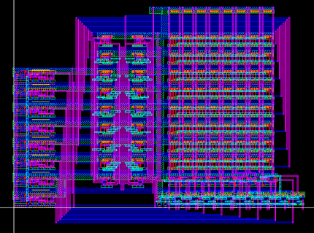
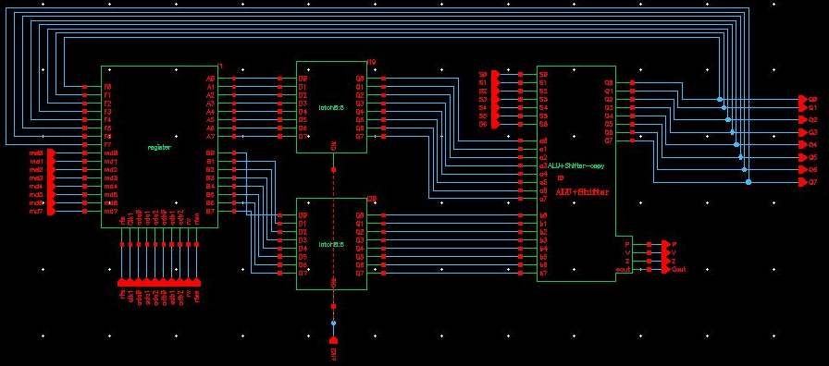
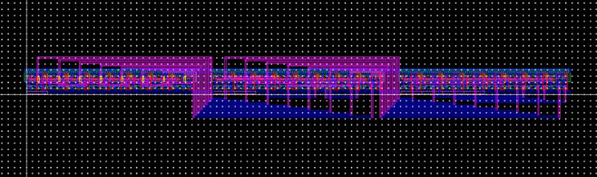
Data Path Characteristics
Height | 328.65 microns
Width | 1018.95 microns
Area | 334.88 square mm
Transistors | 2457
Density
Delay
ALU Description: Our microprocessor has 16 functions and 4 control bits. The ALU is split into two equal components that handle 4 bits each. We utilized a Manchester Carry Look Ahead Adder for our ALU so we could more efficiently add two 8 bit numbers together. Furthermore, in order to reduce they number of transistors our ALU uses, our adder does the logic operations for AND, NAND, and XOR as well since they are required for the adder’s propagate and generate signals. To the side of each adder, 2 control bit signals alter the “B: bit input to change what the adder is doing for different operations. We also added a status register that detects a Zero Flag, Overflow Flag, and Parity Flag. The ALU also outputs a carry out signal as well.
Figure: Full Layout of Data Path
am designed the data path for an 8-bit microprocessor. This data path is capable of arithmetic and logic evaluation, data movement, and storage of results in a memory address specified by the instruction. Our group achieved this by implementing connections between an SRAM module, an ALU and a barrel shifter. Our design features a 16-function ALU, a status register in the ALU to give more information about our output, a high-spSUMMARY
In this project, our teeed shifter, and a memory unit controlled by latches to ensure proper storage of data coming in at different times.
SRAM Description: The Register file of our data path is made up of an 8x8 SRAM array, 2:1 multiplexers for choosing between utilizing data from the output of the data path or new data for the path to perform operations on, 3:8 decoders for selecting the proper cell to access for words A and B, and latches for feeding data into the SRAM array to hold. The individual SRAM cells are based on a 6T design with 6 transistors each that handle the writing and reading of data to and from output and input latches respectively.
Shifter Description: Our barrel shifter schematic and layout are shown below. A challenge we encountered was which schematic to use. There are many different models, but it seems almost all use a base of 2:1 multiplexers. Our shifter uses 24 2:1 MUXs to achieve 5 functionalities. A benefit and hindrance to our design is that we designed a way to route GND to specific inputs in our schematic. Other models of shifters have inner-schematic routing of inputs (no routing to ground). When we used other models of shifters, they added more functionality such as shift 3, and rotate 1 and 2. However, for our design, we did not need these capabilities and choosing to route the way we did greatly improved the timing of our shifter, it is very fast compared to those with more functions.
Manchester Carry Look Ahead Adder
Status Register Layout
Register File Schematic
SRAM 6T Cell Layout
Figure: Full Schematic of Data Path
Register File Layout

